Slide 1
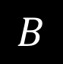
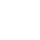
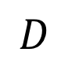
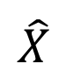
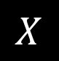
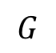
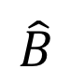
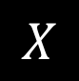
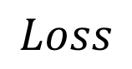
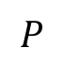
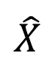
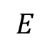
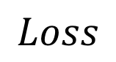
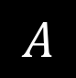
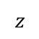
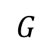
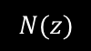
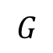
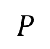
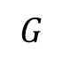
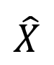
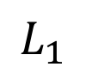
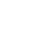
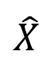
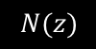
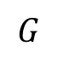
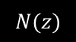
$$G$$
Input Image
$$G$$
$$z$$
$$\hat{X}$$
Ground truth output
$$N(z)$$
$$\hat{X}$$
Network output
$$Loss$$
Loss
(a) Generating a random image on the manifold
$$P$$
$$X$$
Deep network
Target latent distribution
(b) Projecting image x
into the latent space z
Sample from distribution
$$Loss$$
$$L_{1}$$
$$G$$
$$P$$
$$G$$
$$A$$
$$N(z)$$
$$\hat{X}$$
$$X$$
$$z$$
$$\hat{X}$$
$$G$$
$$\hat{B}$$
$$E$$
$$z$$
$$N(z)$$
(a) Generating a random image on the manifold
(b) Projecting image x into the latent space z
$$D$$
$$B$$
(d) Training cLR-GAN

Slide 2
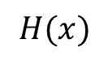
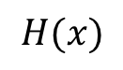
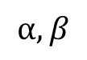
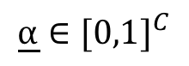
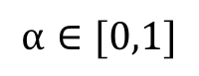
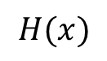
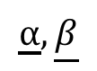
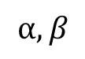
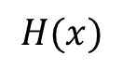
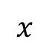
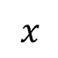
$$H(x)$$
$$H(x)$$
$$⍺,β$$
$$x$$
$$x$$
AdaIn
Vanilla ResNet (No conditioning)
Adaptive Instance Normalization
$$⍺∈[0,1]$$
$$⍺,β$$
+
$$H(x)$$
Scale
$$H(x)$$
Scale+Shift
$$x$$
$$x$$
Blockwise Gating (Scale only)
Blockwise Gating (Scale+Shift)
$$\underline{⍺}∈{[0,1]}^{C}$$
$$\underline{⍺},\underline{β}$$
$$H(x)$$
Scale
$$H(x)$$
Scale+Shift
$$x$$
$$x$$
Channelwise Gating (Scale only)
Channelwise Gating (Scale+Shift)

Slide 3
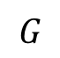
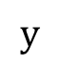
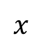
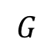
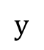
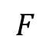
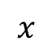
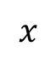
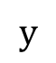
$$G$$
$$x$$
$$x$$
$$x$$
$$G$$
$$G$$
$$G$$
$$y$$
$$y$$
$$F$$
$$⍺,β$$
$$y$$
1-hot Concatenation
(Input only)
1-hot Concatenation
(All layers)
Gated Conditioning
(Ours)

Slide 4
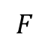
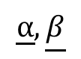
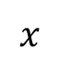











$$x$$
$$x$$
$$x$$
$$G$$
$$G$$
$$G$$
$$y$$
$$y$$
$$y$$
$$⍺,β$$
$$F$$
1-hot Concatenation (Input only)
1-hot Concatenation (All layers)
Gated Conditioning [Ours]
Class label injection
$$⍺∈[0,1]$$
$$\underline{⍺}∈{[0,1]}^{C}$$
$$H(x)$$
$$H(x)$$
Scale
$$H(x)$$
Scale
$$x$$
$$x$$
$$x$$
Vanilla ResNet (No conditioning)
Blockwise Gating (Scale only)
Channelwise Gating (Scale only) [Ours]
$$⍺,β$$
$$\underline{⍺},\underline{β}$$
$$⍺,β$$
$$H(x)$$
$$H(x)$$
Scale+Shift
$$H(x)$$
Scale+Shift
$$x$$
AdaIn
$$x$$
$$x$$
Adaptive Instance Normalization
Blockwise Gating (Scale+Shift)
Channelwise Gating (Scale+Shift)
Variants of Conditional Gating

Slide 5




$$A$$
$$\hat{B}$$
$$x$$
$$x$$
$$G$$
$$G$$
$$G$$
$$y$$
$$y$$
$$y$$
Gating parameters
Naive Concatenation
(Input only)
Naive Concatenation
(All layers)
$$F$$
Gated Conditioning [Ours]
Class label injection
$$⍺∈[0,1]$$
$$\underline{⍺}∈{[0,1]}^{C}$$
$$H(x)$$
$$H(x)$$
Scale
$$H(x)$$
Scale
$$x$$
$$x$$
$$x$$
Vanilla ResNet (No conditioning)
Blockwise Gating (Scale only)
Channelwise Gating (Scale only) [Ours]
$$⍺,β$$
$$\underline{⍺},\underline{β}$$
$$⍺,β$$
$$H(x)$$
$$H(x)$$
Scale+Shift
$$H(x)$$
Scale+Shift
$$x$$
AdaIn
$$x$$
$$x$$
Adaptive Instance Normalization
Blockwise Gating (Scale+Shift)
Channelwise Gating (Scale+Shift)
Variants of Conditional Gating

Slide 6
















$$⍺$$
$$β$$
$$⍺∈[0,1]$$
$$H(x)$$
$$H(x)$$
$$H(x)$$
$$x$$
$$x$$
$$x$$
Vanilla ResNet (No conditioning)
Blockwise Gating (+Shift)
Blockwise Gating
$$\text{⍺}$$
$$\text{β}$$
$$\text{⍺}$$
$$\text{β}$$
$$\text{⍺}∈{[0,1]}^{C}$$
$$H(x)$$
IN
$$H(x)$$
$$H(x)$$
$$x$$
$$x$$
$$x$$
Adaptive Instance Normalization
Channelwise Gating (+Shift)
Channelwise Gating
$$β$$
$$\text{⍺}$$

Slide 7















$$A$$
$$\hat{B}$$
$$A$$
$$\hat{B}$$
$$A$$
$$\hat{B}$$
$$A$$
$$\hat{B}$$
$$\hat{B}$$
$$G$$
$$G$$
$$G$$
$$G$$
$$D$$
Real
/fake
$$y$$
$$y$$
$$y$$
Loss
$$y$$
Gating
parameters
$$y$$
Gating
params
$$\hat{y}$$
$$Q$$
$$F$$
$$F$$
Naive Concatenation
(Input only)
Naive Concatenation
(All layers)
Concat + Auxiliary Classifier /
Latent Regressor
Gated Conditioning [Ours]
Gated Conditioning [Ours]
Class label injection variants
$$A$$
$$\hat{B}$$

Slide 8



Vanilla ResNet (No conditioning)
Blockwise Gating (+Shift)
Blockwise Gating
IN
Adaptive Instance Normalization
Channelwise Gating (+Shift)
Channelwise Gating
$$β$$
$$\text{⍺}$$

Slide 9
$$A$$
$$\hat{B}$$
$$A$$
$$\hat{B}$$
$$A$$
$$\hat{B}$$
$$A$$
$$\hat{B}$$
$$\hat{B}$$
Real
/fake
$$y$$
$$y$$
$$y$$
Loss
$$y$$
Gating
parameters
$$y$$
Gating
params
$$\hat{y}$$
Naive Concatenation
(Input only)
Naive Concatenation
(All layers)
Concat + Auxiliary Classifier /
Latent Regressor
Gated Conditioning [Ours]
Gated Conditioning
Discriminator [Ours]
Class label injection variants
$$A$$
$$\hat{B}$$

Slide 10














































Class-conditioned image-to-image translation
Class-conditioning
Input
Basketball
Soccer
Watermelon
Orange
Cookie
Moon
Strawberry
Pineapple
Cupcake
Fried chicken
GAN-Gate
Naive
Concatenation
(Input)
Naive
Concatenation
(All layers)

Slide 11




Basketball
Soccer
Watermelon
Orange
Cookie
Moon
Strawberry
Pineapple
Cupcake
Fried chicken
Class-conditioned Image Generation
Multimodal Image-to-Image Translation
Disjoint Multitask Image-to-Image Translation
Class-conditioned image-to-image translation

Slide 12
Basketball
Soccer
Watermelon
Orange
Cookie
Moon
Strawberry
Pineapple
Cupcake
Fried chicken
Class-conditioned Image-to-Image Translation
Multimodal (Latent code-conditioned) Image-to-Image Translation
Label map
Synthesized Street scene
Day image
Synthesized Night image
Task-conditioned Multitask Image-to-Image Translation
Class-conditioned image-to-image translation

Slide 13
Basketball
Soccer
Watermelon
Orange
Cookie
Moon
Strawberry
Pineapple
Cupcake
Fried chicken
Class-conditioned Image-to-Image Translation
Multimodal (Latent code-conditioned) Image-to-Image Translation
Label map
Synthesized Street scene
Day image
Synthesized Night image
Task-conditioned Multitask Image-to-Image Translation
Class-conditioned image-to-image translation

Slide 14
Basketball
Soccer
Watermelon
Orange
Cookie
Moon
Strawberry
Pineapple
Cupcake
Fried chicken
Class-conditioned Image-to-Image Translation
Multimodal Image-to-Image Translation
Disjoint Multitask Image-to-Image Translation
Class-conditioned image-to-image translation

Slide 15

















Slide 16















Ground
Truth
Concat
(Input)
Concat
(All)
Concat (In)
+ Aux-Class
Block-
Gate
Channel-
Gate
BlockGate
(with bias)
ChnGate
(with bias)
AdaIn
Concat
(Input)
Concat
(All)
Channel-
Gate
Per-class
Generator
'perclass'
'our_baseline_input',
'our_baseline_all',
'acgan_baseline_input',
'acgan_baseline_all',
'block_gated',
'gated_channel',
'block_gated_affine',
'gated_channel_affine',
'adain',
'munit_baseline_input',
'munit_baseline_all',
'gated_channel_munit',
basketball_11 , chicken_2 , cookie_13 , cupcake_27 , moon_15, orange_17 , pineapple_2, soccer_18, strawberry_1 , watermelon_17

Slide 17










Input
EncDec
Concat (All)
SkinnyResNet
Concat (All)
SkinnyResNet
Concat (All)+Aux Class
SkinnyResNet ChannelGate [Ours]
\includegraphics[width=.18\linewidth]{channel_gated/cityscapes_95_real_A} &
\includegraphics[width=.18\linewidth]{munit_baseline_all/cityscapes_95_fake_B} &
\includegraphics[width=.18\linewidth]{our_baseline_all/cityscapes_95_fake_B} &
\includegraphics[width=.18\linewidth]{acgan_baseline_all/cityscapes_95_fake_B}&
\includegraphics[width=.18\linewidth]{channel_gated/cityscapes_95_fake_B} \\
\includegraphics[width=.18\linewidth]{final_images/channel_gated/night2day_35_3106_to_3109_real_A.jpg} &
\includegraphics[width=.18\linewidth]{munit_baseline_all/night2day_35_3106_to_3109_fake_B} &
\includegraphics[width=.18\linewidth]{our_baseline_all/night2day_35_3106_to_3109_fake_B} &
\includegraphics[width=.18\linewidth]{acgan_baseline_all/night2day_35_3106_to_3109_fake_B} &
\includegraphics[width=.18\linewidth]{channel_gated/night2day_35_3106_to_3109_fake_B}\\

Slide 18





Partial Outline
Autocompleted Outline
Pix2pix(Outline)
Pix2pix(Partial Outline)
Pix2pix(Partial Edges)

Slide 19






























Basketball
Soccer
Watermelon
Orange
Cookie
Moon
Strawberry
Pineapple
Cupcake
Fried chicken

Slide 20



























Strawberry
Pineapple
Cupcake
Basketball
Soccer
Watermelon
Orange
Cookie
Moon
Strawberry
Pineapple
Cupcake
Fried chicken
Class-conditioned Image-to-Image Translation
Multimodal (Latent code-conditioned) Image-to-Image Translation

Slide 21
Increasing user input
User
Input
Completed
Outline
Translated
Image
Basketball
Soccer
Watermelon
Orange
Cookie
Moon
Strawberry
Pineapple
Cupcake
Fried chicken
Class-conditioned Image-to-Image Translation
Multimodal (Latent code-conditioned) Image-to-Image Translation

Slide 22



























Increasing user input
Cookie
Strawberry
Fried chicken
Moon
Pineapple
Cupcake

Slide 23
Increasing user input
Cupcake
Strawberry
Pineapple
Basketball
Soccer
Watermelon
Orange
Cookie
Moon
Strawberry
Pineapple
Cupcake
Fried chicken
Class-conditioned Image-to-Image Translation
Multimodal (Latent code-conditioned) Image-to-Image Translation

Slide 24
Input class
Cookie
Pineapple
Strawberry
Previous stroke (black)
Added strokes (green)
Completed outline (gray)
Translated image
Increasing user input

Slide 25





Pix2pix(Trained on Partial Outline)
Partial Outline
Autocompleted Outline
Pix2pix(Trained on Partial Edges)
Pix2pix(Trained on Outline)

Slide 26









